Slide 1
Topic 9: Over-dispersion + zero-inflation

Slide 2
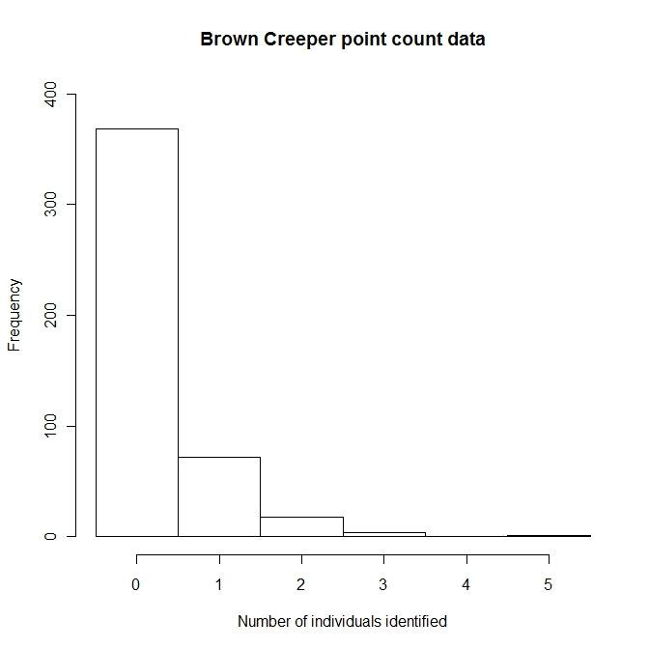
Other GLM’s and overdispersion
Poisson
Negative Binomial (NB)
Zero Inflated Poisson
Zero Inflated NB

Slide 3
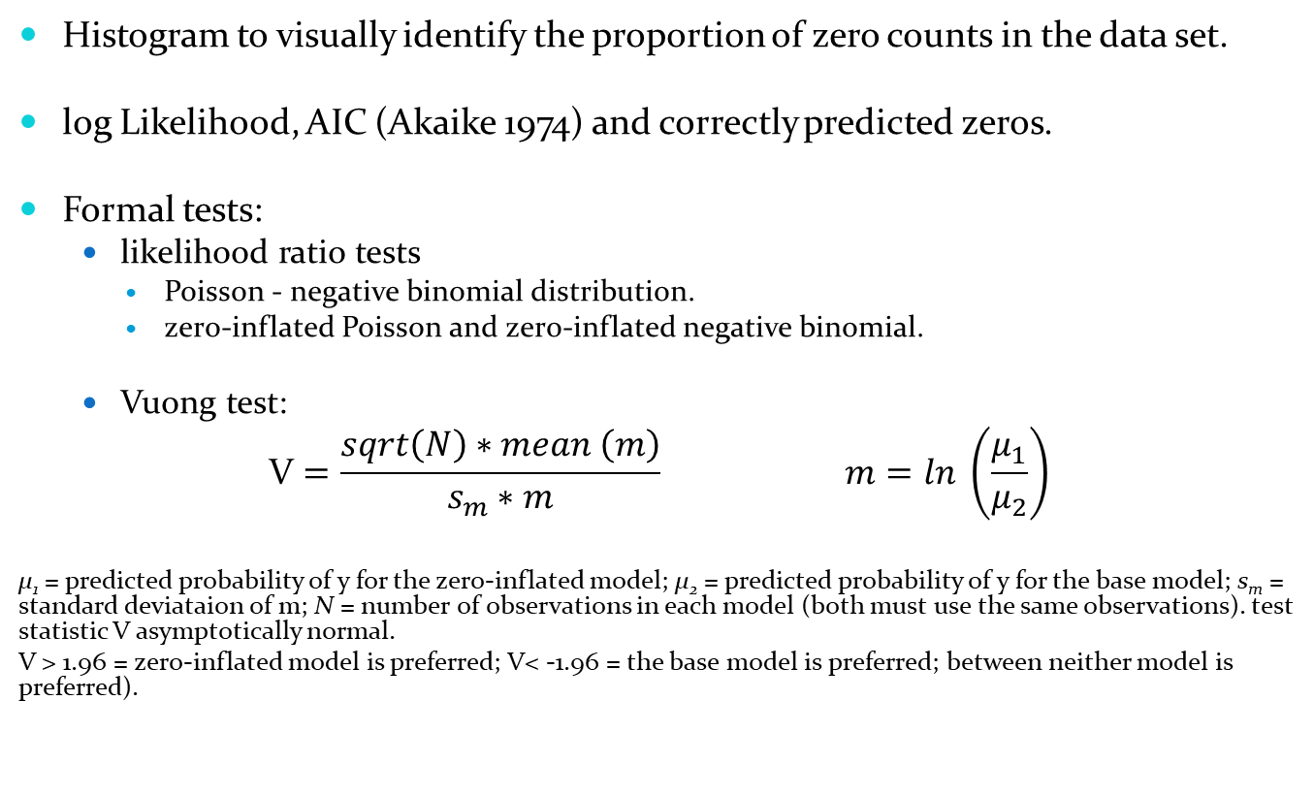
Test which distribution fits the data best
Histogram to visually identify the proportion of zero counts in the data set.
log Likelihood, AIC (Akaike 1974) and correctly predicted zeros.
Formal tests:
likelihood ratio tests
Poisson - negative binomial distribution.
zero-inflated Poisson and zero-inflated negative binomial.
Vuong test:
$$\text{V}=\frac{sqrt\left(N\right)∗mean \left(m\right)}{s_{m}∗m} m=ln \left(\frac{μ_{1}}{μ_{2}}\right)$$
μ₁ = predicted probability of y for the zero-inflated model; μ₂ = predicted probability of y for the base model; s_{m} = standard deviataion of m; N = number of observations in each model (both must use the same observations). test statistic V asymptotically normal.
V > 1.96 = zero-inflated model is preferred; V< -1.96 = the base model is preferred; between neither model is preferred).

Slide 4
Results
True 0’s | GLM |  | Zero inflated
368 |  | negative |  | negative
 | Poisson | binomial | Poisson | binomial
no. parameters | 4 | 5 | 8 | 9
-2* log Lik | -274.924 | -272.284 | -266.696 | -266.518
AIC | 557.847 | 554.569 | 549.392 | 551.036
predicted 0's | 361 | 368 | 368 | 369
Likelihood ratio tests
Poisson – negative binomial:
χ² = 5.2785, df=1, p=0.010795
ZI Poisson – ZI NB:
χ² = 0.3552, df=1, p=0.2756
Vuong tests:
ZI NB – NB:
1.739 (p = 0.041)
ZI Poisson – Poisson:
1.505 (p = 0.066)

Slide 5
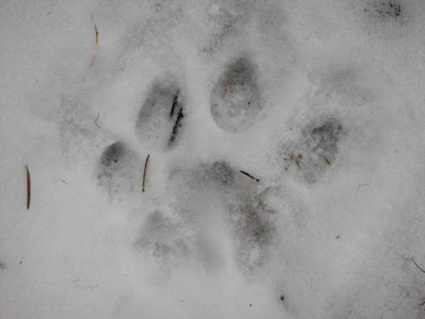
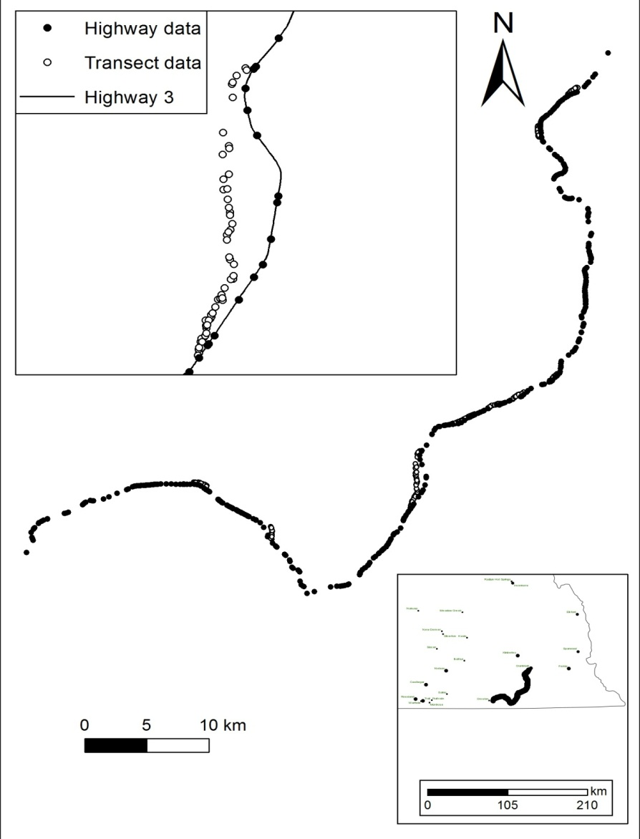
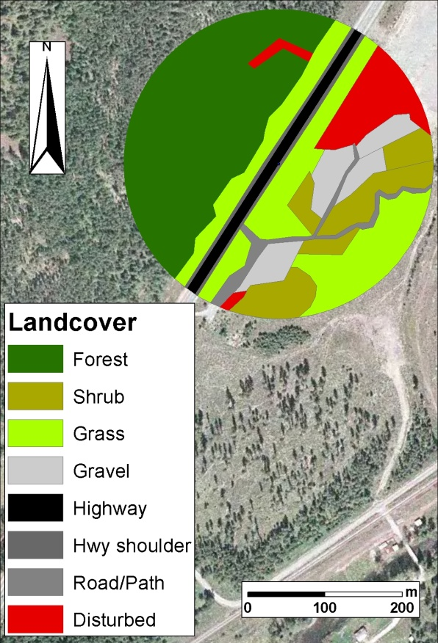
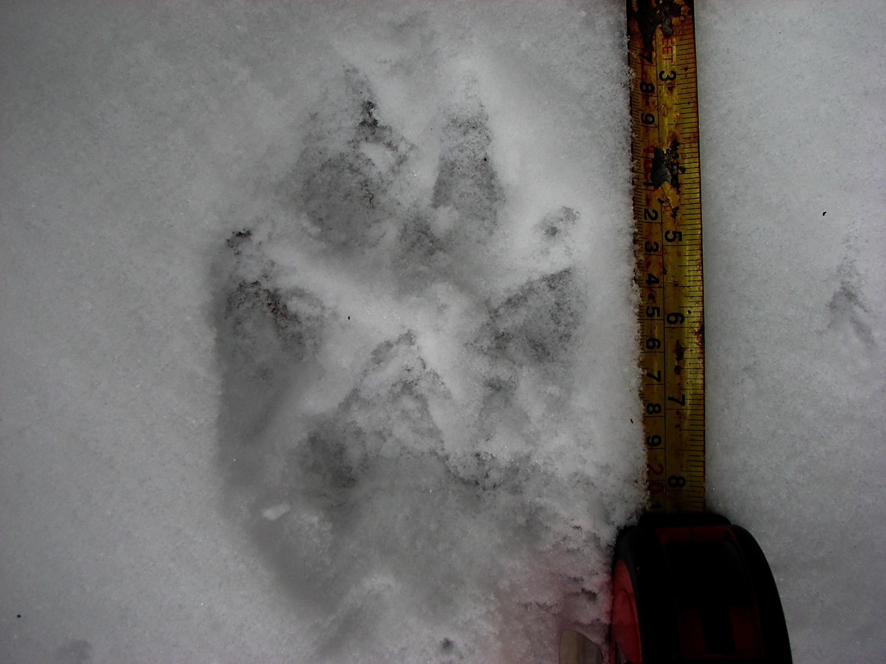
Multiscale highway effects on a large mammal community
Schuster, Germain & Römer in revision

Slide 6
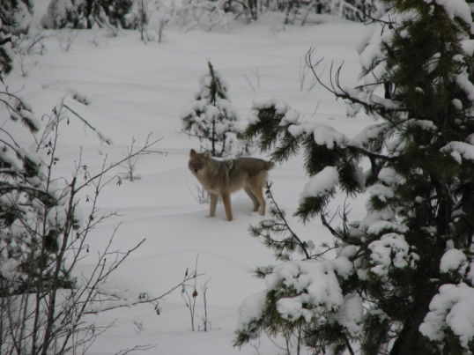
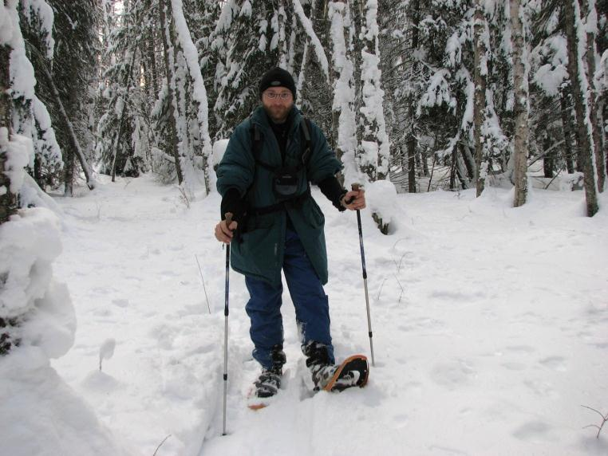
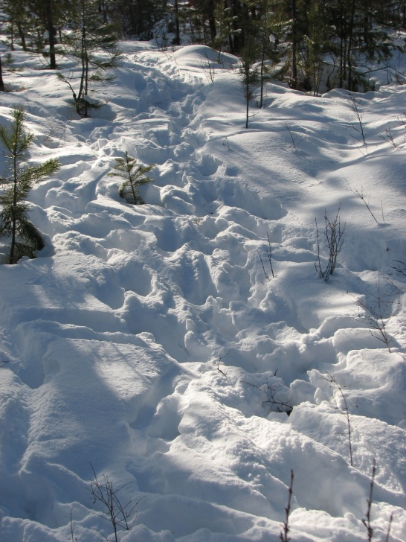
Setup
Highway 3 in SE BC between Creston and Cranbrook
Identify potential crossing sites
2 seasons of snow track data
Highway 96km
9 Transects off highway total 13km
Species data: deer, moose, elk, coyote, bobcat, cougar, wolf, …

Slide 7
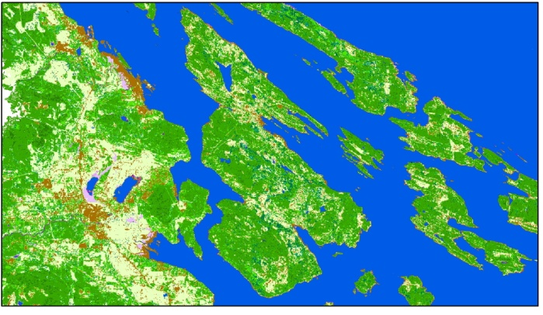

Analysis
Distribution choices similar to previous example
Models:
3 scales individually and in combination (200, 500, 1000m) using Landsat derived variables
hand digitized variables (200m)
Combine all
Predictive maps using Landsat data

Slide 8
